Slide 1
Preheater profile Introduction and TASK
Technical Development Program SPREAD 2016

Slide 2
Objectives / Scope of a preheater check tool
Objectives
Show efficiency of the preheater (Δp, ΔT)
Quantify reserves through velocities within the preheater (cyclone inlet, dip tube)
Quantify amount of false air intake in preheater tower
Benchmark with typical range of preheater profile
Scope
Gas and meal temperature profile across preheater
Pressure profile of the preheater
Oxygen and CO profile of the preheater
Check of velocities through the preheater

Slide 3
Preheater check – Step 1: Preliminary work
Dimensions required to be filled in the “Geometry” sheet
Drawings required to check gas velocities:
Dip tube and riser duct of each stage
Tertiary air duct (inside lining)
Calciner diameter inside lining or equivalent diameter if different shape.
Kiln diameter inside lining.
Drawings required to check gas residence time in calciner:
Entire calciner: Active volume = volume inside refractory between first fuel feed point and inlet of bottom cyclone

Slide 4
Preheater check – Step 2: Inspection
Inspection of preheater before measurement
Check-list during inspection (for each stage):
Is there a splash box?
Is there a flap in meal duct?
Is the meal flap working?
Location of measurement points:
Open, and check if still free (no lining).
Check distance from splash box (if measurement port in riser duct)

Slide 5
Preheater check – Step 3: Measurements
Measurements required
Temperature
Pressure
Oxygen and CO
Fuel rate
Kiln feed rate
Kiln feed moisture
Location of measurements:
Kiln inlet
Tertiary air
Calciner (including orifice)
Outlet of each stage
Notes:
Nbr of measurment points for calciner: depending on calciner size.
Probable high fluctuations of temperature, oxygen and CO mesurement in calciner.

Slide 6
Preheater check – Step 4: Fill out the tool
The gas flow calculation uses the same formula as in your PPE reference guide.
V min from combustion of fuel
CO2 from raw material
Excess air
Water vapor from RM (top stage)

Slide 7
Preheater check tool – online presentation
New standard tool (can select number of strings, number of stages, with ILC or/and SLC, bypass, etc…)
It is composed of 4 sheets: Geometry, Measurements, Calculations and Evaluation.
Note: In case of precombustion chamber use in-line configuration. For residence time, if a more accurate calculation is required, do a separate calculation

Slide 9
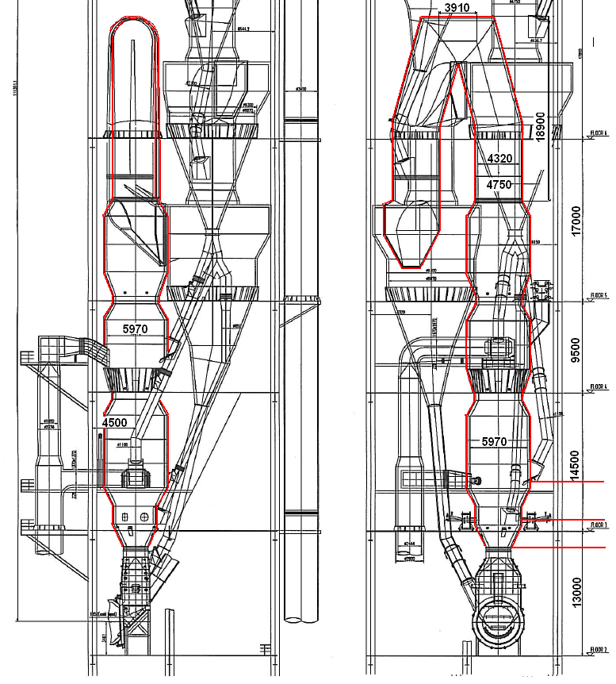
Task 1: Estimate Active volume of Calciner
Determine the boundaries of the calciner active volume.
Select the correct active volume of calciner to enter in tool (length of calciner goose neck part is 39.9m)
- 940 m3
- 1‘370 m3
- 1‘620 m3
30300

Slide 10
Task 2: Fill out missing measurements
Choose the most likely correct value between CCR and measurement and propose root cause of the difference.
Static Pressure at stage 4 outlet:
CCR reading: -29 mbar
Measurement: -24 mbar (measured in cyclone roof because no measuring port free in riser duct).
Meal temperature (stage 5)
CCR reading: 860°C
Measurement: 900°C
Gas temperature (stage 3)
CCR reading: 650°C
Measurement: 590°C

Slide 11
Task 3: Oxygen and calcination degree
Enter different oxygen content (kiln inlet, preheater exit) and observe impact on gas flow (ex: How much % increase of gas flow for +1%O2?)
Enter different calcination degree and observe impact on gas flow at kiln inlet.

Slide 12
Task 4: False air and Preheater efficiency
Quantify amount of false air
Discuss preheater efficiency

